Slide 1
Most Watched Videos
Presentation of Information

Slide 2
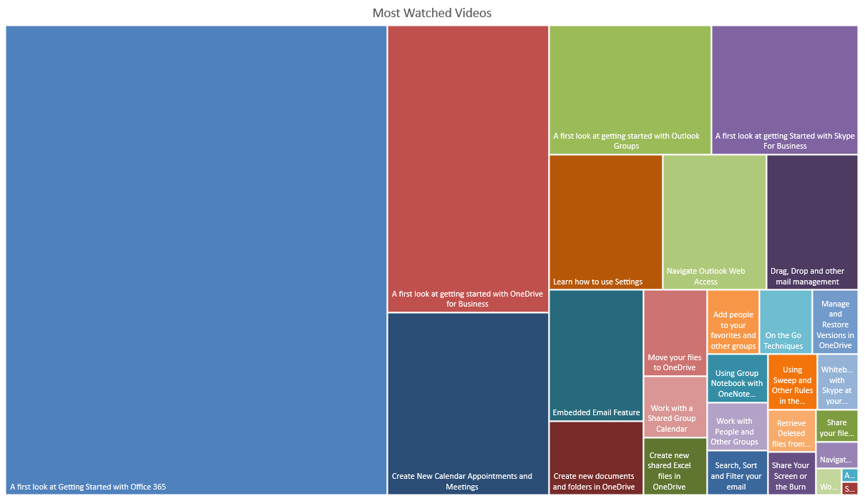

Slide 3
